Slide 1

Resume Classification

Slide 2

Presented by
Mr. Saurabh Sunil Diwane
Mr. Akash Shankar Linganwar
Mr Botla Sachin
Miss. Nandi Preetha
Miss. Daggumilli Priya Madhuri
Mr. Hari Krishna Guvvala

Slide 3
Index
1
OBJECTIVES
2
DATA SUMMARY
3
EDA and VISUALIZATIONS
4
MODEL BUILDING AND MODEL EVALUATION
5
MODEL DEPLOYMENT
5
CONCLUSION

Slide 4
OBJECTIVES
Resume classification solution should significantly reduce the manual human effort in the HRM.
The objective is to improve the accuracy of resume parsing and information extraction, so that key details such as education, work experience, and skills can be accurately identified and used for classification.
In this project we have Developed a model to automatically classify resumes into different job categories, such as React JS Developer, Workday Resumes, Peoplesoft Resumes ,etc.
Develop a user-friendly interface that is easy to use and navigate, making it simple for recruiters to discover and select appropriate resumes for the similar job postings.
The ultimate goal is to develop a model that can automate the process of candidate screening, saving time and improving the efficiency of the recruitment process.

Slide 5
DATA SUMMARY
Given dataset contain four folders of resumes category like Peoplesoft Resume , Workday Resume, React JS Developer Resumes and Hexaware Resumes.
Peoplesoft Resume = 20 Resumes
Workday Resumes =14 Resumes
React JS Developer Resumes =23 Resumes
Hexaware Resumes = 21 Resumes
At First , We’ve imported the necessary libraries required to perform the tasks.
Using Function refer in snip we’ve stored all the Resumes in one data frame with column names
‘Resumes , Category’ and proceed with the Cleaning of data by regular expressions using NLTK library.
We’ve removed stopwords ,hashtags ,web links, mentions ,extra whitespaces from the data.
And convert all the data in csv file and proceed for EDA.

Slide 6
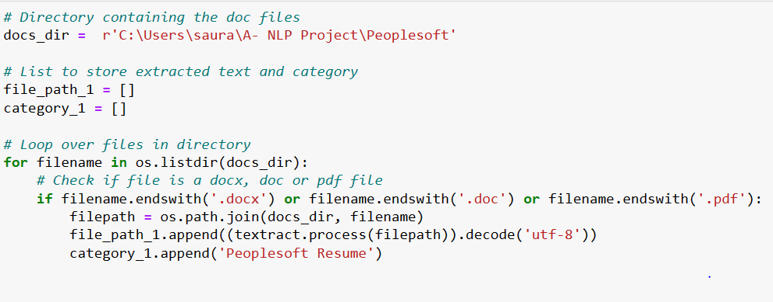
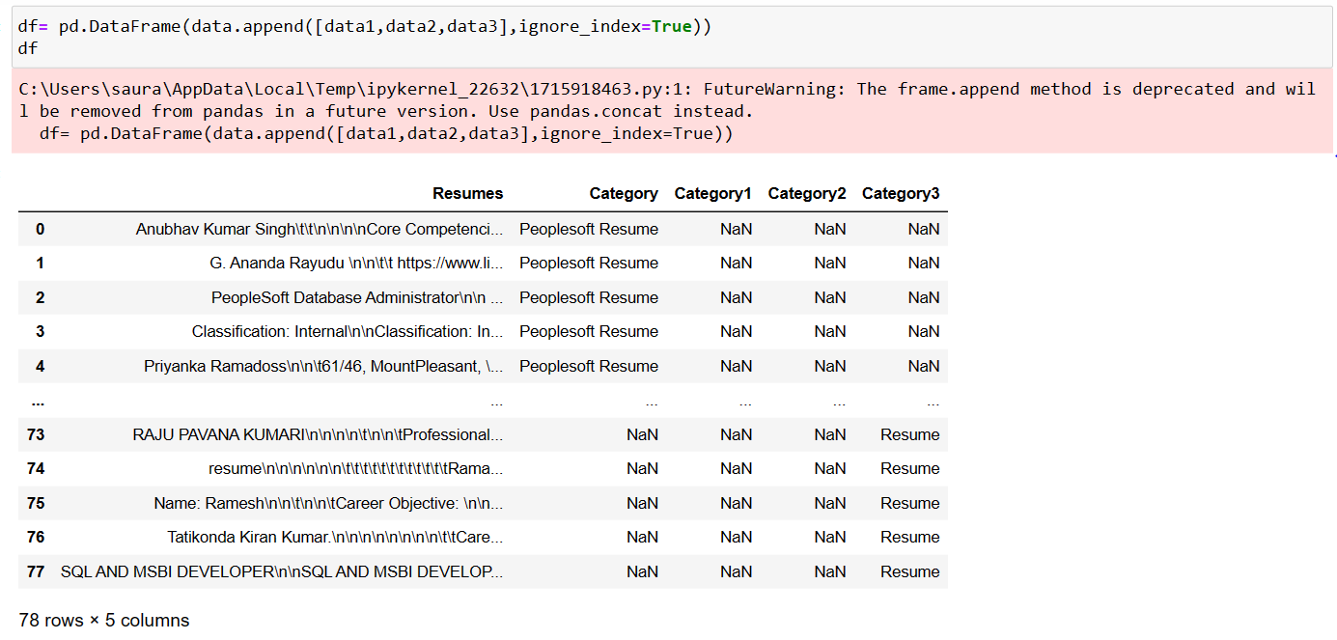
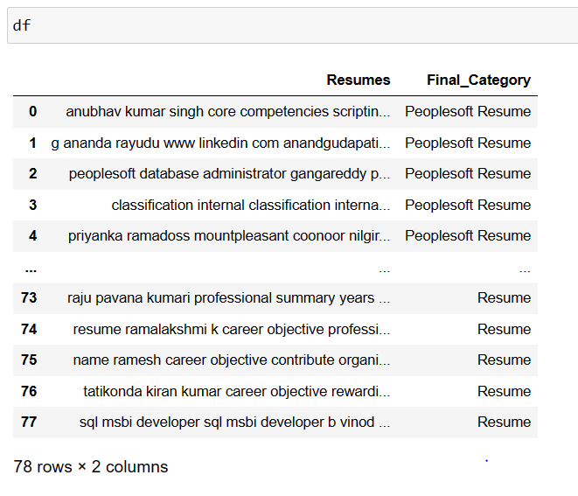
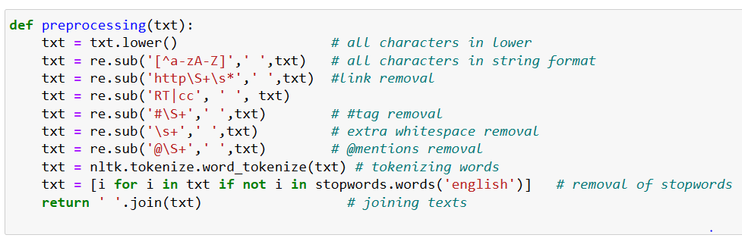

Slide 7
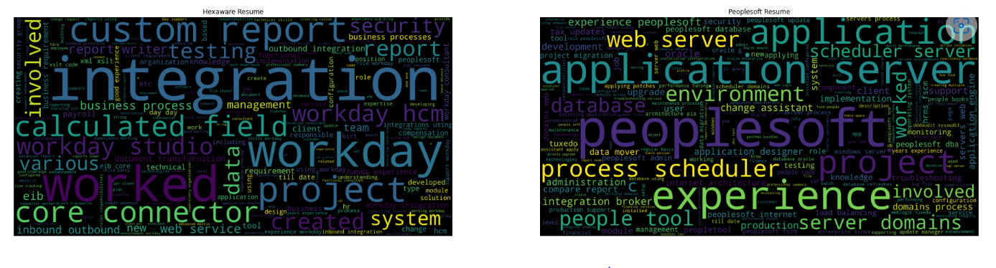
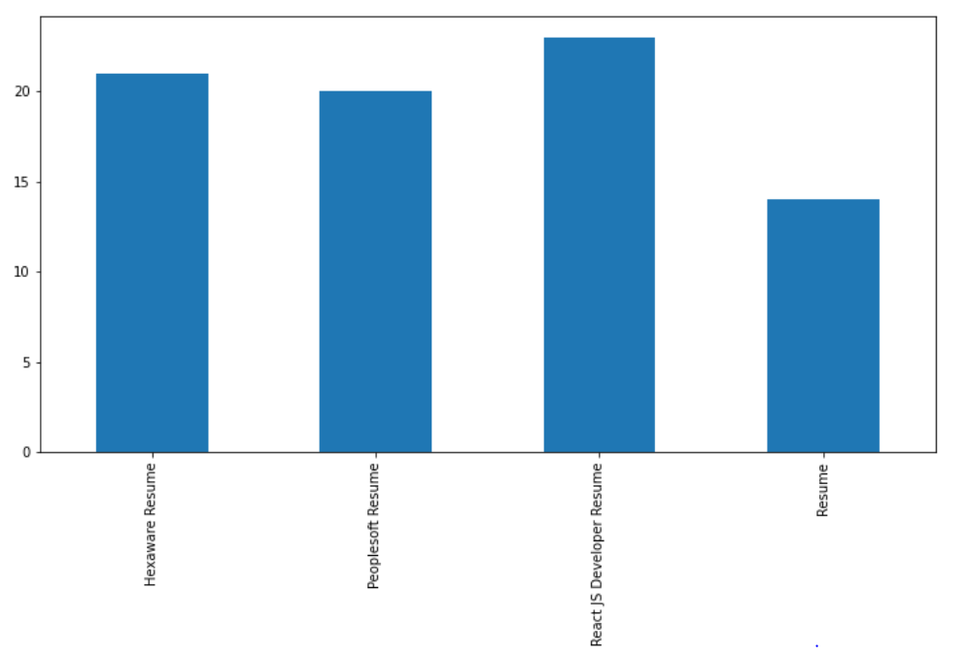
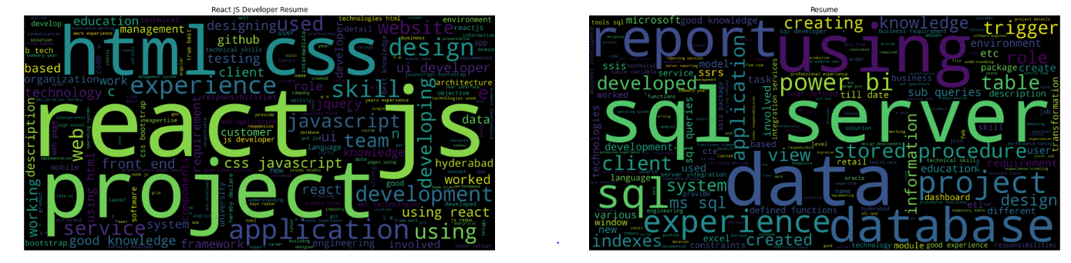
EDA AND VISUALIZATIONS
We’ve created a function to check the most common keyword used in the resumes and their frequency, also we have lemmatize the similar keyword using Wordnetlemmatizer.
After lemmatizing the resumes filtered column as per the category unique values and we’ve plotted the data distribution with respect to category.
We’ve also plotted the wordclouds for each category to check the frequency of most occurring keywords in each category of resumes.

Slide 8
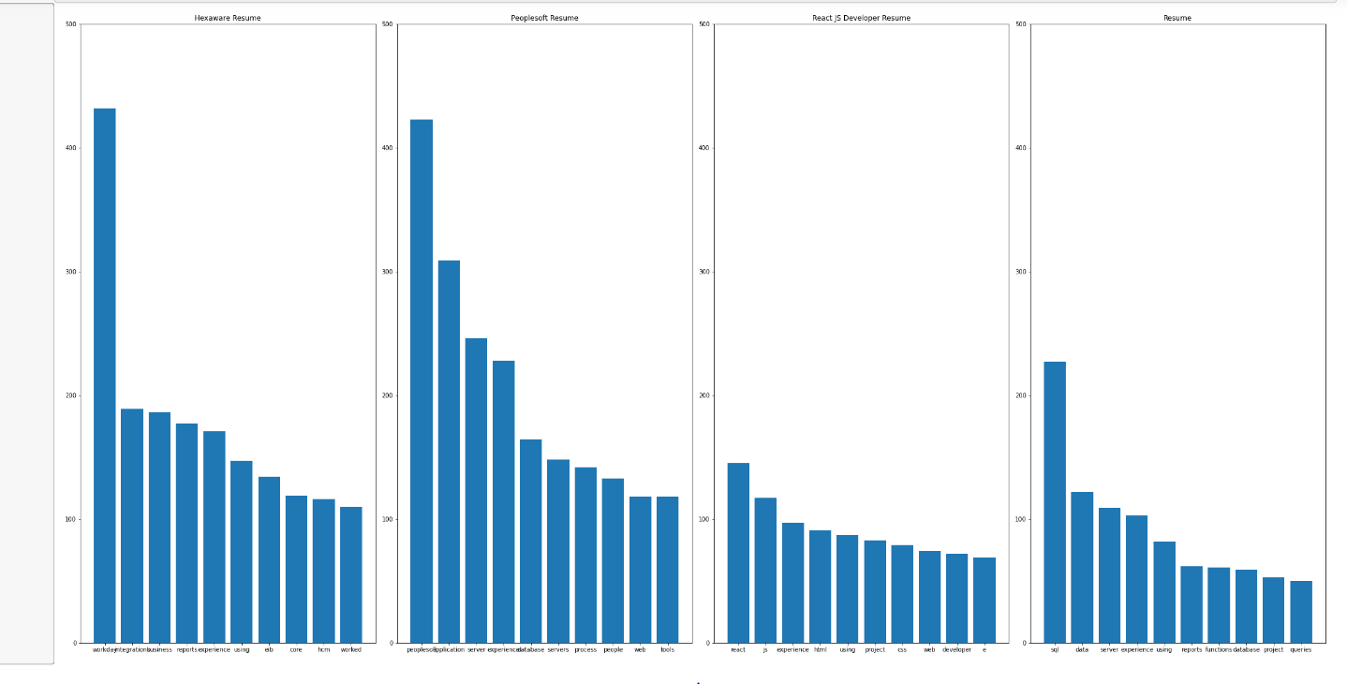
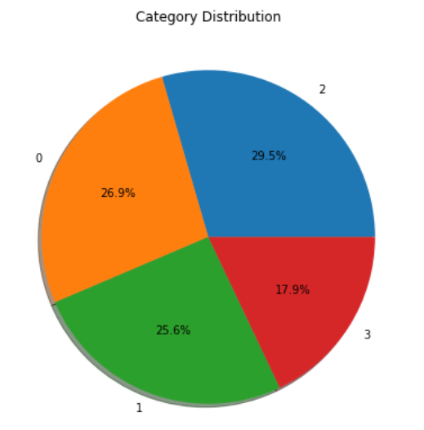
Most Common Words and Category Distribution Charts
Below visual (left) refer to distribution of most common words occurring in the resumes from the respective categories of job roles
Visual in the right show the category distribution of resumes.

Slide 9
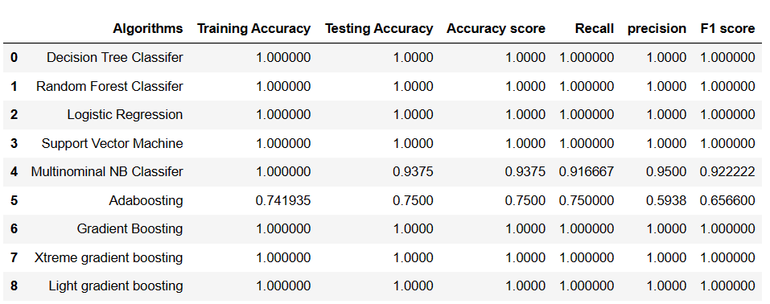
MODEL BUILDING AND MODEL EVALUATION
We’ve divided the data using train-test split and used TfidfVectorizer to convert text data into a numerical representation that can be used by machine learning models. It stands for Term Frequency-Inverse Document Frequency and is a way to measure the importance of a word in a document
We’ve used Random Forest, Logistic Regression, Multinominal Navies Bayes, Adaboosting, Gradient Boosting, Xtreme Gradient boosting ,Light Gradient Boosting classifiers to train the model
We’ve calculated accuracy score, recall score, precision score and F1 score for every model
Most of the model shows maximum accuracy in both training and testing datasets.
We’ve taken Random Forest model as our final model for model deployment.

Slide 10
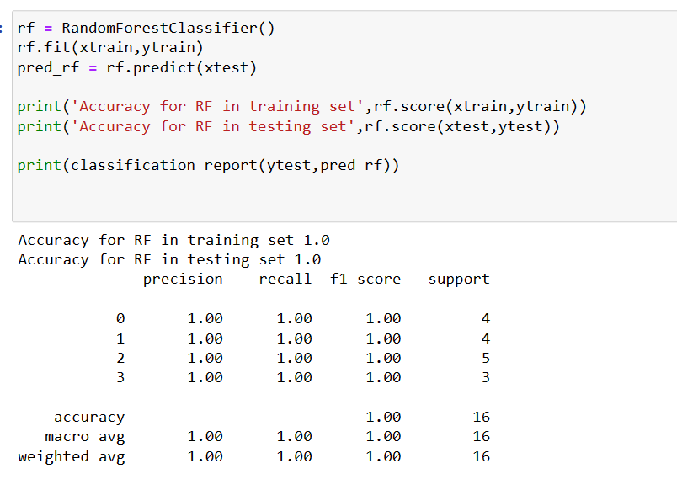
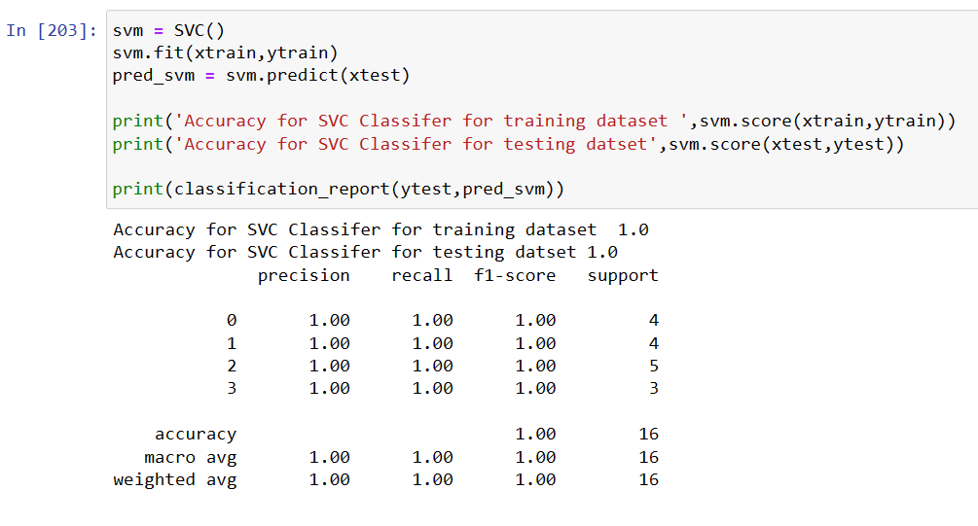
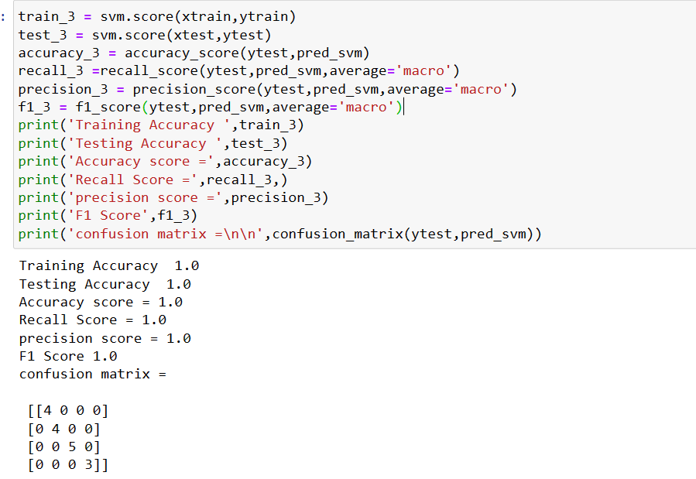
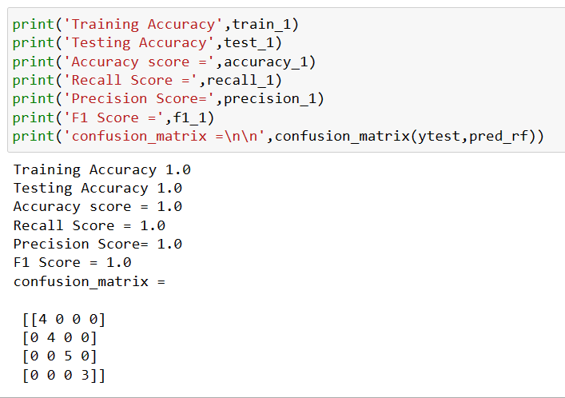

Slide 11
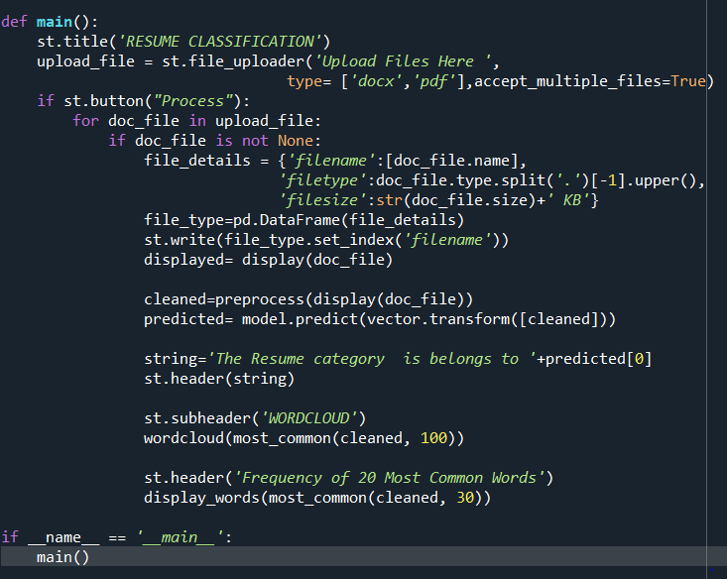
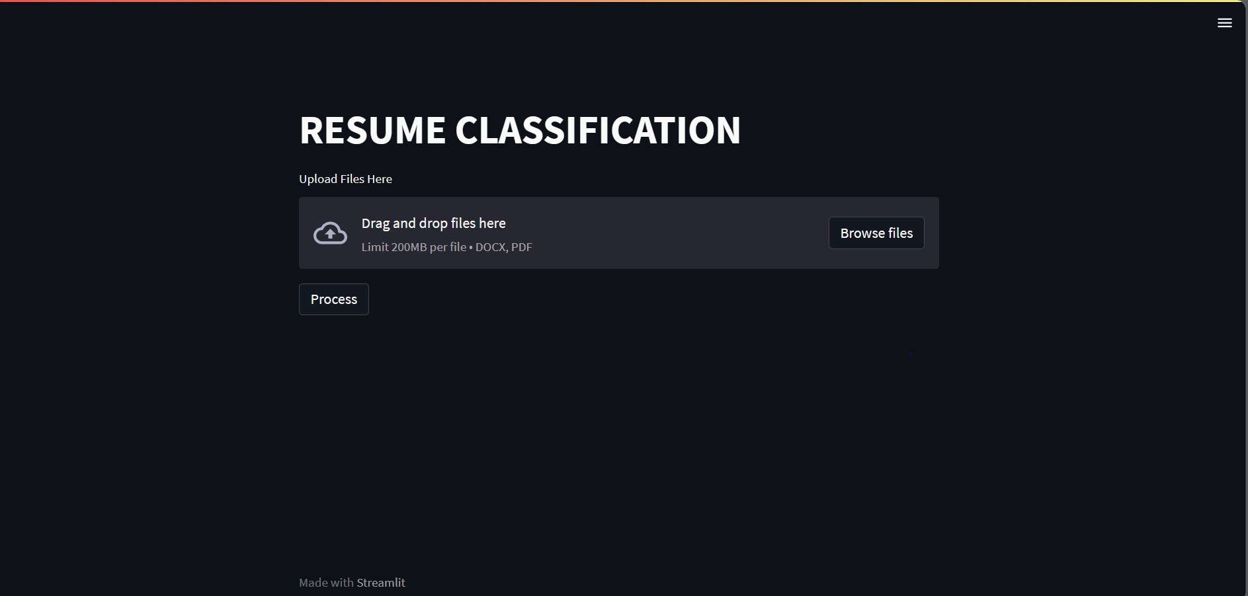
Model Deployment
We’ve deployed our model in Streamlit web framework.
below snip refer to the homepage of our model.

Slide 12
CHALLENGES FACED
Sorting and preprocessing the data.
Cleaning and calculate frequency of keywords was bit tricky.
Practicing data visualization was challenging and fun.
Model deployment codes were challenging as issue we were facing was TFIDFVectorizer were not fitted in the training dataset.
Overall tasks were performed smoothly.

Slide 13
Conclusion
In the resume classification project, the main goal was to develop a machine learning model that could classify resumes into different categories based on their content. The categories could include different job roles, industries, or experience levels.
Different machine learning algorithms were used for model training and evaluation, including logistic regression, support vector machines, and neural networks. The models were evaluated using various metrics, such as accuracy, precision, recall, and F1-score.
In conclusion, the resume classification project demonstrated the effectiveness of machine learning techniques in processing large volumes of text data and extracting meaningful insights from it. The project has practical applications in human resources, talent acquisition, and job matching, and can help streamline the recruitment process and improve the quality of job matches.

Slide 14
Thank You.

